Slide 1
Simulation and optimization of the coupling efficiency from single-mode fibers to photonic waveguides
Buyu Xiao
Examinors: Prof.Dr.-Ing. Rolf Schuhlmann

Slide 2
Overview
Motivation and Objective
Project Introduction
Modelling
Optimization
Conclusion and Outlook

Slide 3
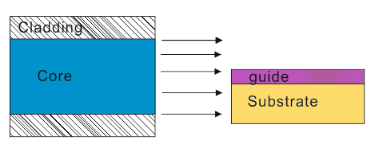

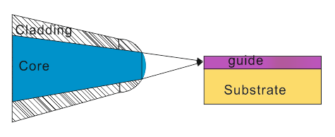
Motivation and Objective
Fiber-to-Chip
Motivation:
Fiber-to-Chip?
Coupling problems.
Tapered lensed Fiber.
Objective:
Analyzing different techniques to affect coupling efficiency.
Improving coupling efficiency.
Notes:
In integrated optic it is often to project light from optical fibers to photonic waveguides (so called Fiber-to-Chip).
As the signal source optical fibers have usually a larger end face than that of waveguides and the direct coupling from fibers to waveguides cause a very low coupling efficiency.
So tapered and lensed fibers (TLF) are applied to replace regualar fibers. Through TLF light power is confined in small range adapting to waveguide dimensions.
But it is not the only solution for promoting the coupling efficiency. There are more actions can be done for optimizing the coupling.
This work aim to analyze different techniques to affect the coupling from TLF to waveguide, and find out the optimal configurations. The caurse of light propagation can be divided in 3 tracks.The TLF handle the propagation at track 1. Following we talking about the optimal actions at track 2 and 3.

Slide 4
Overview
Motivation and Objective
Project Introduction
Modelling
Optimization
Conclusion and Outlook

Slide 5
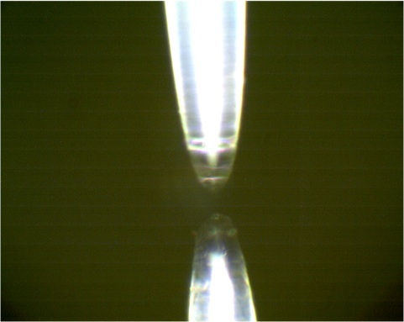
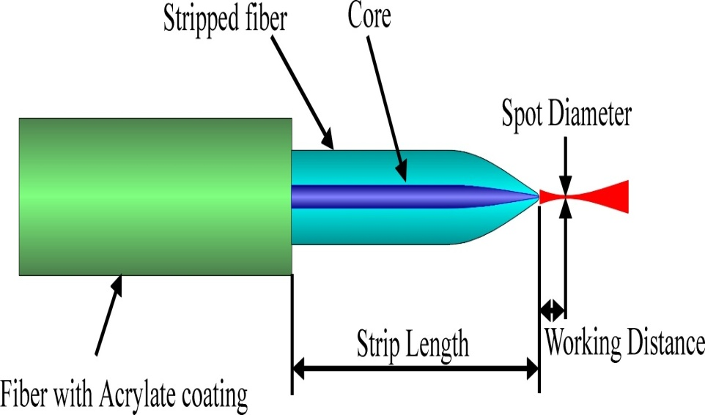
Project Introduction
Tapered Lensed Fiber
Parameters |  | Specifications(Single-mode)
Spot size | Minimum | 1.7µm(λ=1.5µm)
 |  | 0.6µm(λ=0.5µm)
 | Maximum | 6.0µm(λ=1.5µm)
Spot size Tolerence | Without near-field characterization | ±0.5µm
 | With near-field characterization | ±0.25µm
Working Distance | Minimum | 5µm (λ=1.5µm)
 | Maximum | 50µm (λ=1.5µm)
Additional : working distance 4µm(λ =1064nm)
Source:http://www.nanonics.co.il/lensed-fibers.html
Notes:
In last page we have shown the schema of coupling from TLF to waveguide.
The given TLF in the experimental setup is produced by NANONICS. It is fabricted by pulling and melting the regular fiber.
The top figure is the photography of the TLF. The figer right down is the schematic TLF.
The Table gives the technical detail of the TLF in experimental setup.

Slide 6
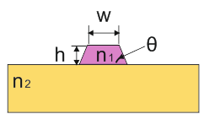
Project Introduction
Waveguide
Working wavelength :λ=1064nm
Waveguide: LiNbO3 with n1=2.516,
w≈1µm, h ≈ 0.5µm
Substrate: SiO2 with n2=1.544
Notes:
The waveguide in this experimental setup is a rib waveguide. The cross-section of the waveguide is a taper. The taper angle is very close to 90 grad. Therefore, the waveguide can approximate a rectangle.

Slide 7
Overview
Motivation and Objective
Project Introduction
Modelling
Optimization
Conclusion and Outlook

Slide 8
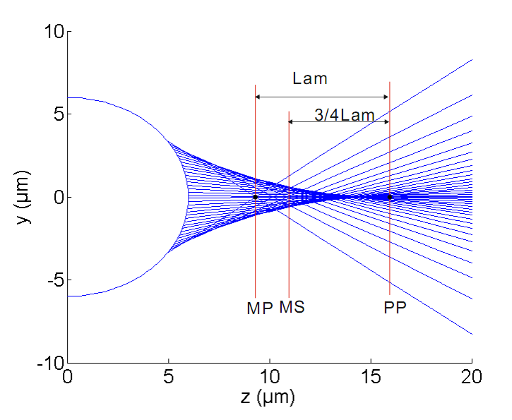
Modelling
Modelling TLF
Working distance:
minimum spot(MS)
Marginal plane(MP)
Paraxial focal plane(PP)
Logitudinal spherical
Aberration(LAm)
Notes:
In this work only the end part of the TLF is modelled. First step is to determine the lens. But the lens geometric parameters are not clearly given, so it can only be derived from its output properties in previous table. For the wide angle lens the minimum spot location(MS) is estimated by following method. The marginal ray has a focus at the optic axis. The plane through this focus is named Marginal plane(MP).The paraxial ray hits the optic axis at paraxial focus and the plane through it is called Paraxial focal plane(PP). The distance between MP and and PP is called longitudinal spherical aberration (LAm). Fromm PP backward ¾ LAm is the location of MS.

Slide 9
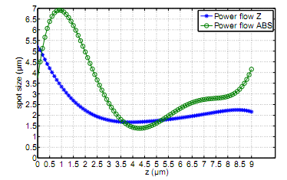
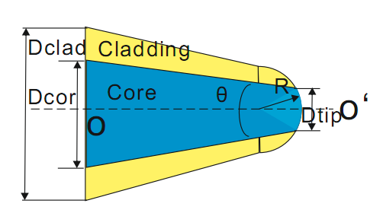
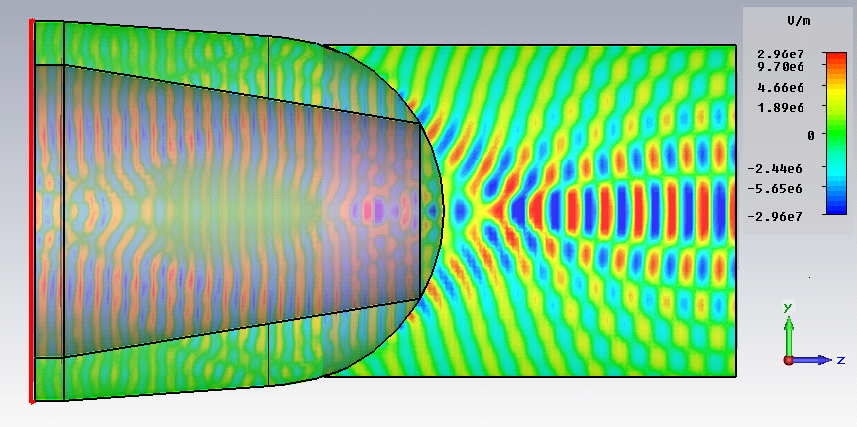
Modelling
Modelling TLF
 | 6
R(µm) | 6
ncore | 1.68
nclad | 1.66
Dclad(µm) | 17
Dcore(µm) | 10
Dtip(µm) | 6
Notes:
´Here we assume the lens end is a hemisphere radius of 6 µm. Through the estimation of working distance of previous page and we derivate the refractive index. The table give the parameters of TLF model in simulations. Screenshots of E-field

Slide 10
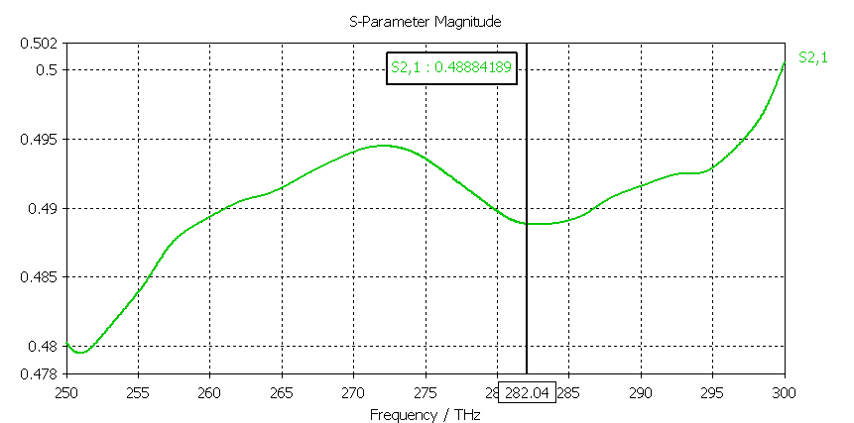
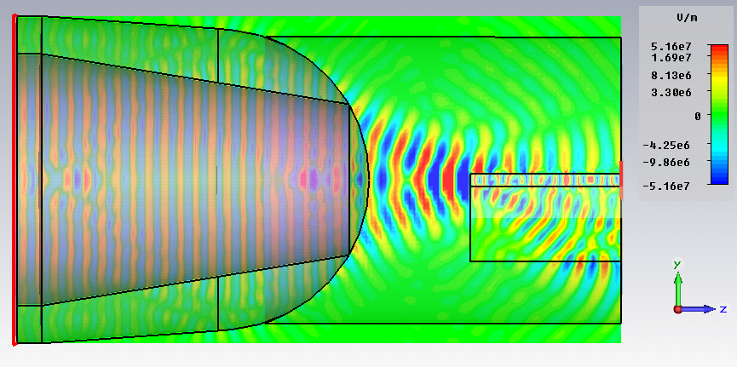
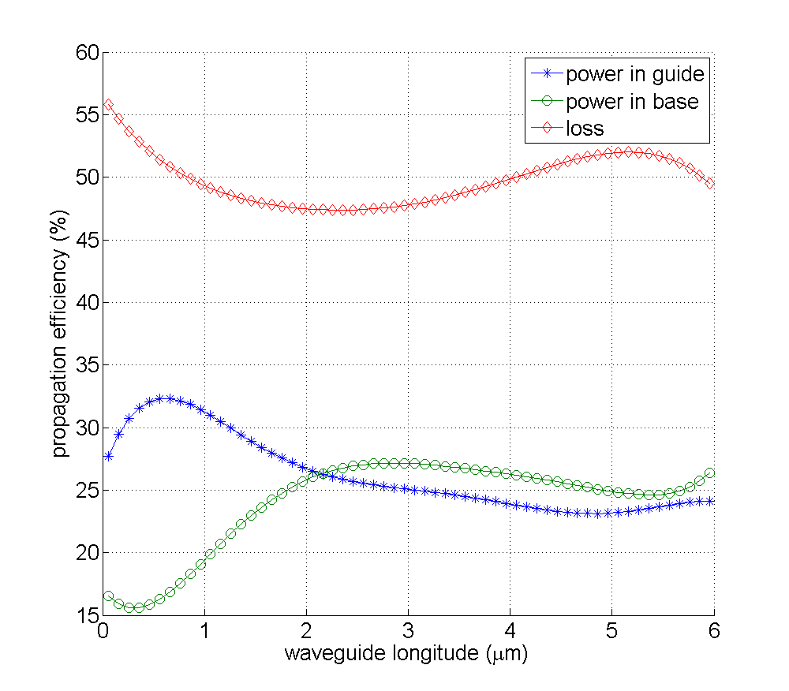
Modelling
Modelling fiber-to-chip-interfac
Coupling efficiency (S21) at working frequency
E-Field
Power distribution in section

Slide 11
Übersicht
Motivation and Objective
Project Introduction
Modelling
Optimization
Conclusion and Outlook

Slide 12
Optimization
Optimization tracks

Slide 13
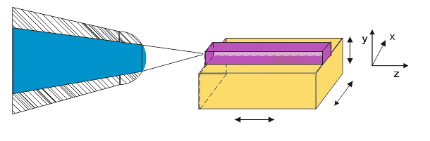
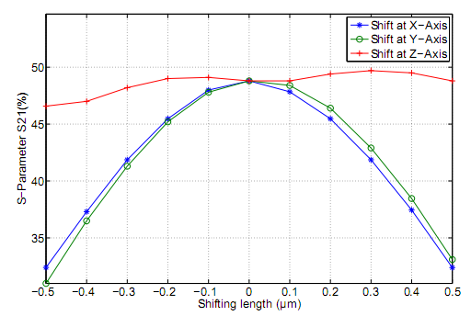
Optimization-Track2
Displacement of waveguide

Slide 14
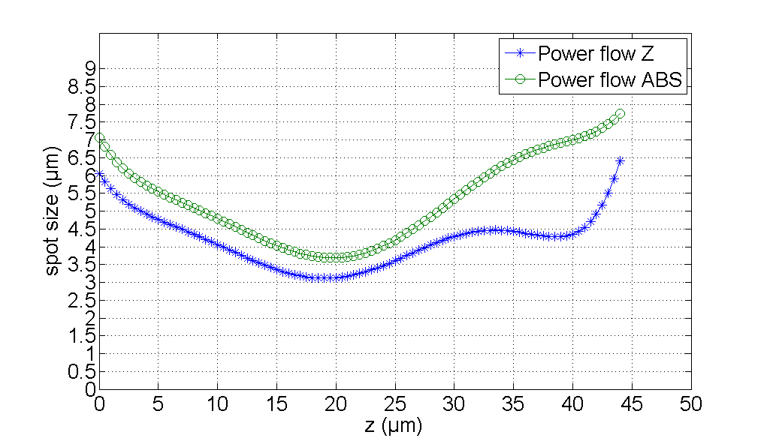
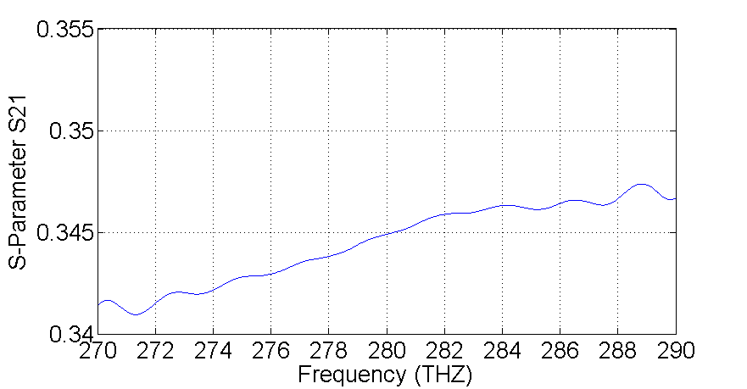
Optimization-Track2
Coupling in oil

Slide 15
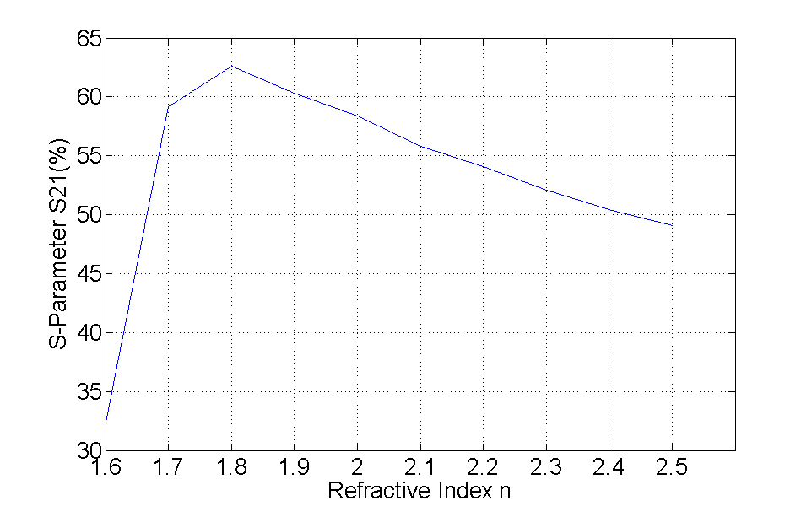
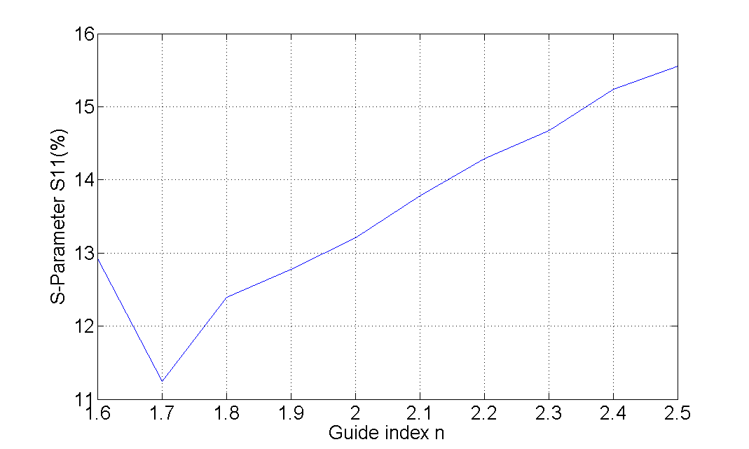
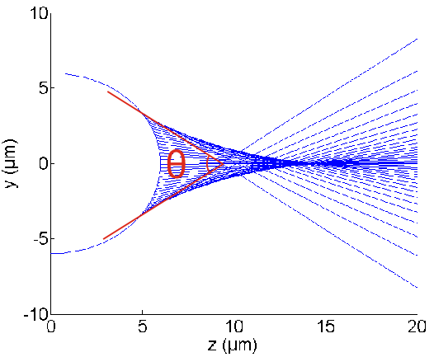
Optimization-Track3
Refractive Indices
Numerical Aperture (NA)
0.43(n=1.6);
0.711(n01.7)
0.925(n=1.8);
0.798(106°)
Reflection

Slide 16
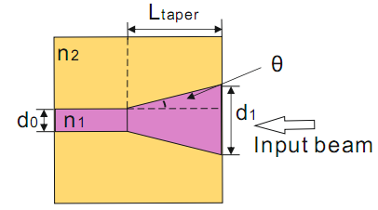
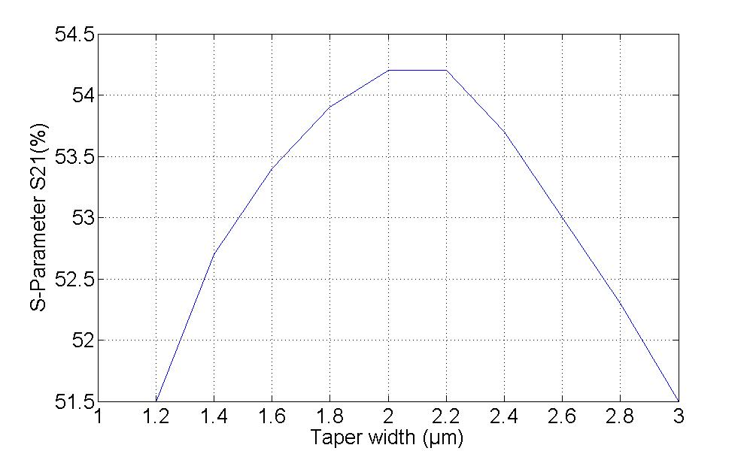
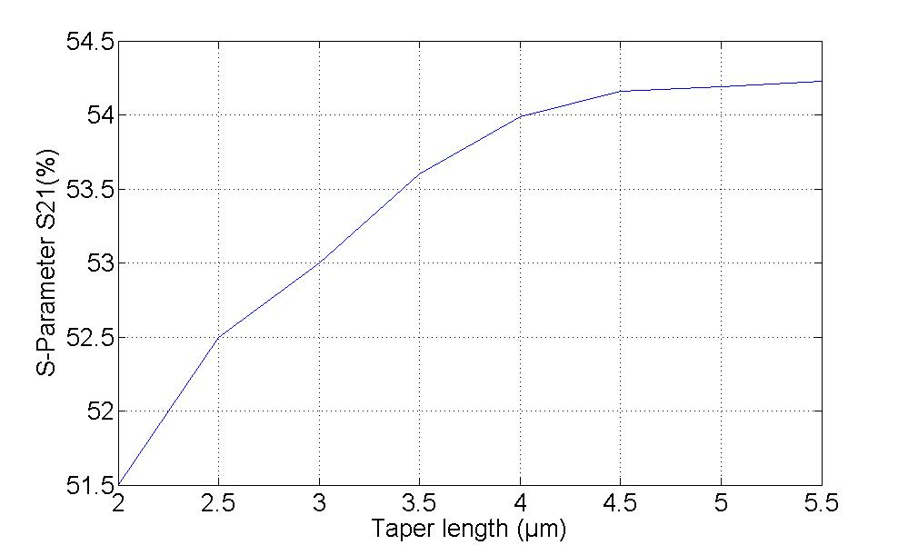
Optimization-Track3
Tapered Waveguide
What is a tapered waveguide
Coupling by varying taper width
Coupling by varying taper height
(Reason)

Slide 17
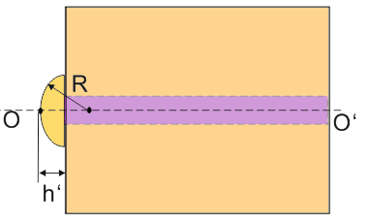
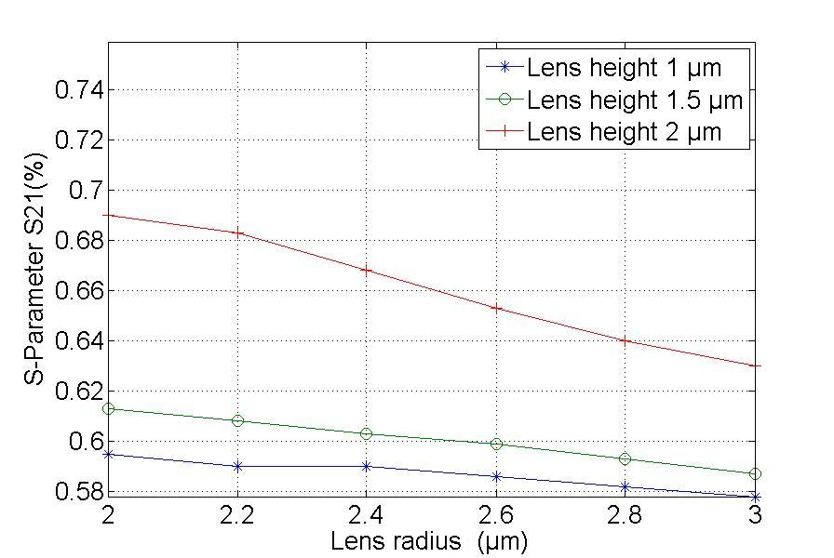
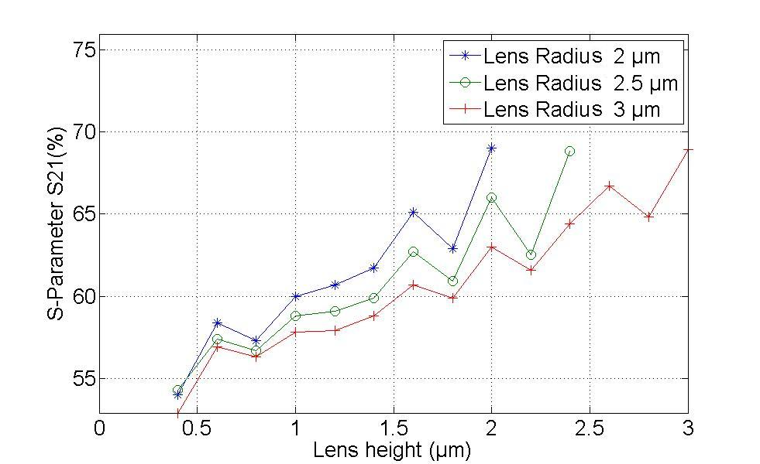
Optimization-Track3
Lensed Wavguide
Coupling efficiency due to lens height
Coupling efficiency due to lens radius
Spot size

Slide 18
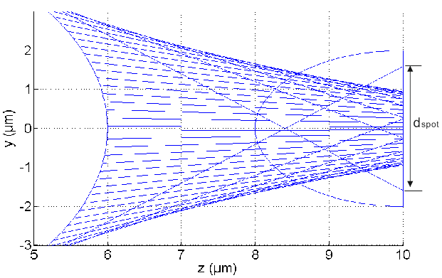
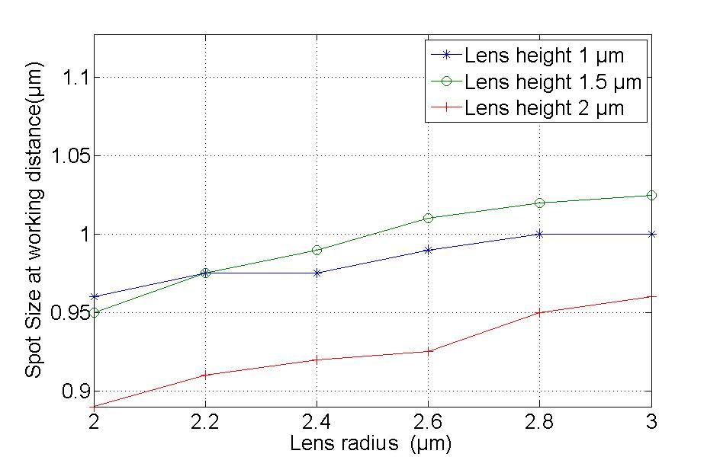
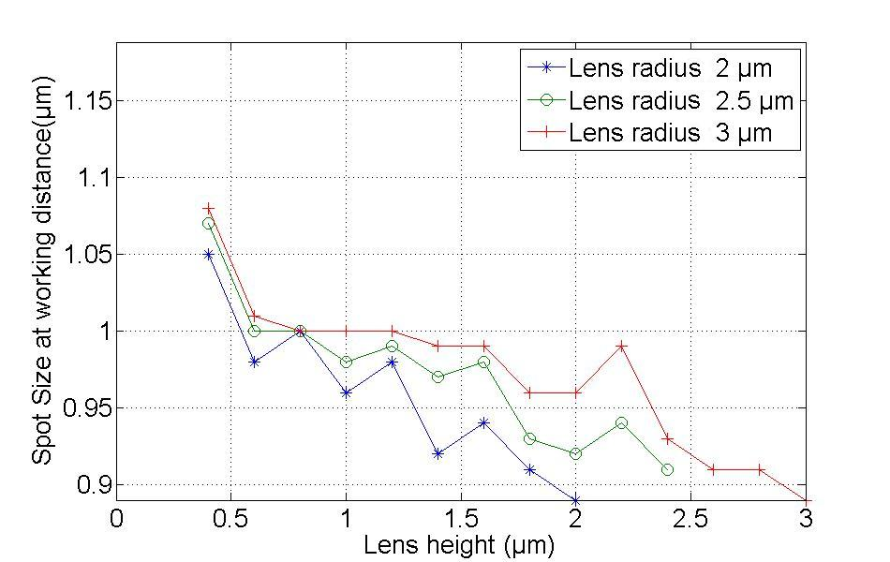
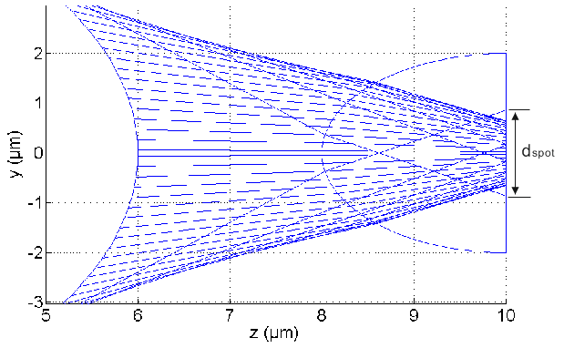
Optimization-Track3
Lensed waveguide
Spot Size

Slide 19
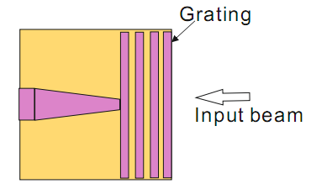
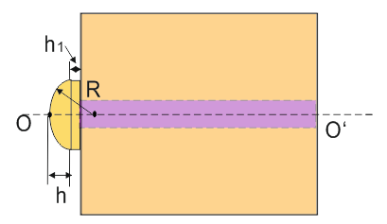
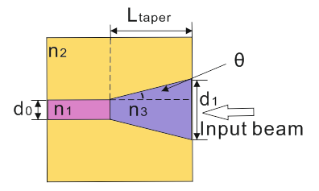
Optimization
Other optimal actions

Slide 20
Overview
Motivation and Objective
Project Introduction
Modelling
Optimization
Conclusion and Outlook

Slide 21
Conclusion and Outlook

Slide 22
Zusammenfassung und Ausblick
Bislang in float gemessen,
double Fehler wurde heute mittag gefunden.
Performanceverbesserungen
durch adaptive Kernelwahl möglich,
aber noch nicht eingebaut.
Problemgrößen für N < 2.000.000 handhabbar.

Slide 23
Thank you
For your attention

Slide 24
Reference
NVIDIA CUDA BestPracticesGuide 2.3
NVIDIA CUDA PrommingGuide 2.3
CudaReferenceManual.pdf
White Paper “Accelerateing MATLAB with CUDA Using MEX Files”
Gaußsches Eliminationsverfahren
http://de.wikipedia.org/wiki/Gau%C3%9Fsches_Eliminationsverfahren
Peter sonneveld, Martin B. Van Gijzen, “IDR(s):A Family of simple and fast algorithms for solving large nosysmmetric systems of linear equations”
Robert Sedgewick,” Algorithmen in C .”, Pearson Studium , ISBN-10: 3827371821
Donald E. Knuth, The Art of Computer Programming 1-3, Addison-Wesley Longman, ISBN-10: 0201485417
David A. Patterson, John L. Hennessy, Computer Organization & Design: The Hardware/Sofware Interface; Morgan Kaufmann; ISBN-10: 155860491X
Brian W. Kernighan, Dennis Ritchie; The C Programming Language; Prentice Hall International; ISBN-10:0131103628

